Slide 1

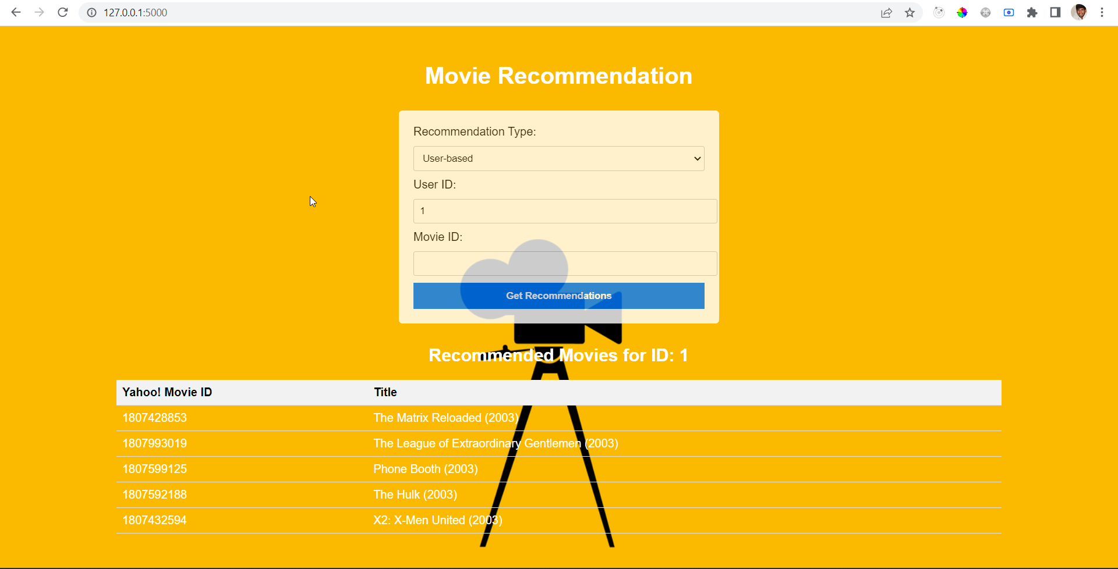
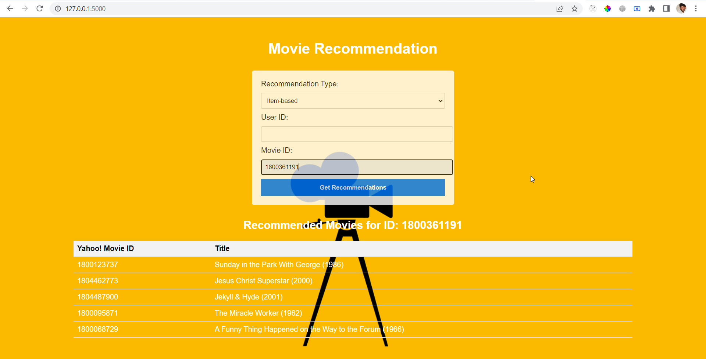
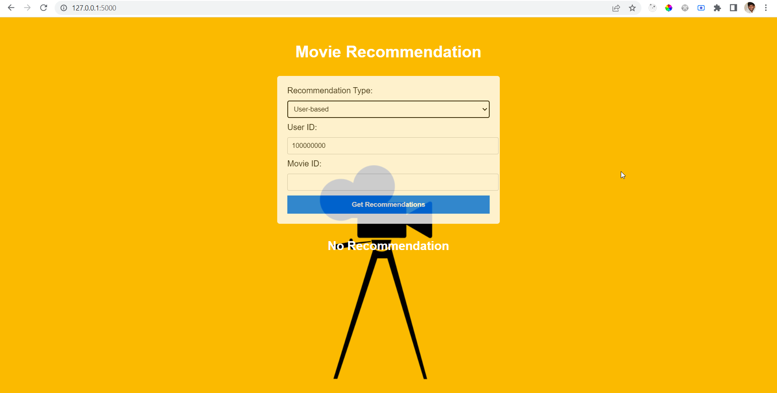
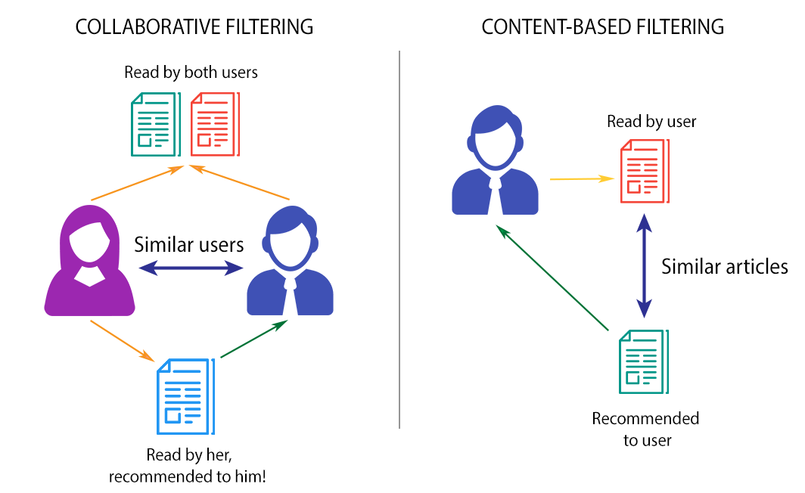
.
Movie Magic: Personalized Recommendations through User and Item-Based Filtering
Lourdu Rohith Reddy Gali
Rohit J Kate
Department of Applied Science And Engineering, College
Introduction
Recommendation systems have become an essential tool for companies to improve customer satisfaction and revenue.
These systems predict user preferences and suggest suitable options based on their behaviour and past purchases. As a result, customers tend to rely on these recommendations to make their purchases, and companies generate a significant amount of revenue from returning customers.
However, creating an accurate recommendation system that caters to individual preferences can be challenging. Each user has unique tastes and preferences that may depend on various factors, such as their mood, the occasion, or the reason for their purchase. Therefore, companies need to continually improve their recommendation systems to meet users' evolving needs.
My project focuses on designing a movie recommendation system that uses collaborative filtering algorithms and the Flask framework.
The system considers past movie ratings given by various users to provide personalized suggestions to the user.
Collaborative filtering algorithms analyze user behaviour and ratings to identify patterns and similarities in their preferences.
The Flask framework is used to develop a website that displays recommendations to the user.
By implementing this system, we aim to improve the user experience by providing accurate and personalized movie recommendations. Ultimately, this can increase user engagement and satisfaction, leading to increased revenue for the company
Fig-1: User-Based and Item-Based Filtering.
Methods
Dataset:
The movies dataset used in my experiment is obtained from the Yahoo Research Webscope database. The database provides two files namely Yahoo! Movies User Ratings and Yahoo! Descriptive Content Information, v.l.O. The Yahoo! Movies Users Ratings file contains 211231 records and consist of User ID, Movie ID and Ratings. The Yahoo! Movies Descriptive Content Information file contains 106959 records and consists Movie ID, Title, Genre, Directors, Actors and so on.
Data Cleaning:
The Movies Descriptive Content Information file had around 40 columns, but only a few were needed for my experiments, so I removed the unnecessary ones. There were also many blank and duplicate values in the dataset, which I addressed. Moreover, I found some entries in the Movies Users Ratings file that didn't match any movie in the Movies Descriptive Content Information file, and I eliminated those entries to simplify the processing.
Model Building:
For User based filtering, I used the cosine similarity to determine the similarity between users' ratings; hence the preference.The item-based filtering is implemented using the k-nearest neighbours model using the cosine similarity metric and the brute-force algorithm.
Flask Web Application:
This application allows displaying the recommended movies. The movie information is filtered and stored in a Pandas DataFrame. Finally, the DataFrame is rendered using a Jinja template and displayed to the user.
Results
Fig-2: User-based filtering
Fig-3: Item-based filtering
Fig-4: No recommendations Found
Major Challenges
With recommender systems, the following issues are always raised. I evaluate my system based on these issues and propose an implementation design to resolve them.
Firstly, the New User Problem is concerned with the scenario when a new user is added to the recommender system. There are no ratings provided by him/her for any movie in the system yet. This is also called a User Cold Start.
One simple possible resolution can be to recommend top-rated movies or the most recently added movies to this new user.
Secondly, there is a concern that no new item is recommended. It can be understood as an Item Cold Start problem. When a new movie is added to the system, it does not have any ratings associated with it. How can it be discovered and recommended?
One resolution can be to recommend movies similar to the genre of top-rated movies. If the new movie falls into that genre, it will get discovered. However, in this resolution, I will need to build a system based on the genre of the movies.
Keeping these known issues apart, either of the two approaches can be used based on the infrastructure. For item-based, the similarity computation is large of the order MxM (M: total movies) but since it is static, we can do it offline and re-compute it only after some threshold time. On the other hand, expensive to do at runtime as for each user, the neighborhood is dynamic with new ratings from different users. Therefore, the former requires cache data storage, latter requires a dedicated processing server.
Conclusions
In this project, I have implemented a movie recommendation system using collaborative filtering. This system is developed using Python and Flask framework and takes the ratings given to movies into consideration to provide movie suggestions.
Literature cited
C. -S. M. Wu, D. Garg and U. Bhandary, "Movie Recommendation System Using Collaborative Filtering," 2018 IEEE 9th International Conference on Software Engineering and Service Science (ICSESS), Beijing, China, 2018, pp. 11-15, doi: 10.1109/ICSESS.2018.8663822.
PythonBasics. (n.d.). What is Flask? – Python Tutorial. Retrieved from https://pythonbasics.org/what-is-flask-python/
M. Gupta, A. Thakkar, Aashish, V. Gupta and D. P. S. Rathore, "Movie Recommender System Using Collaborative Filtering," 2020 International Conference on Electronics and Sustainable Communication Systems (ICESC), Coimbatore, India, 2020, pp. 415-420, doi: 10.1109/ICESC48915.2020.9155879.
B. Sarwar, G. Karypis, 1. Konstan , 1. Riedl, "Item-based collaborative filtering recommendation algorithms", Proceedings of the 10th international conference on World Wide Web, pp. 285-295, 2001
Acknowledgments
I'd like to thank my professor, Rohit J Kate, for his guidance and assistance.
For further information
Lourdu Rohith Reddy Gali
Lgali@uwm.edu
+1(414)-509-9392

